Slide 1
AIGA - Content Calendar
June 8, 2020 - June 14, 2020
Michaela Ganezer

Slide 2

June 8, 2020
Social Channel/Network: Instagram
Target Audience: High School Students
Actual Text:
  Design is all around you. You can change the world. Learn more about what design can do for you. Go to aiga.org and connect with designers!
Links:
  https://www.aiga.org
Influencers: Saul Bass, Steve Jobs
Results/Data

Slide 3

June 9, 2020
Social Channel/Network: Instagram
Target Audience: All Designers
Actual Text:
  So many design programs, so many things to learn. Expand your skills in design and your portfolio. Come connect with other designers and learn more about the Adobe programs from tutorials, to key shortcuts, or how to use a program from the beginning.
Links:
  https://www.aiga.org
Influencers: Chip Kidd
Results/Data

Slide 4

June 10, 2020
Social Channel/Network: Instagram
Target Audience: Design Students
Actual Text:
  AIGA is here to help during this tough time. We provide resources to support you and your designs. Find anything from tutorials, shortcuts, lessons, etc. Let’s see what we can create together!
Links:
  https://www.aiga.org
Influencers: Tom Bancroft
Results/Data

Slide 5

June 11, 2020
Social Channel/Network: Instagram
Target Audience: All Designers
Actual Text:
  “Design is not just what it looks like & feels like. Design is how it works.” - Steve Jobs. Design makes an impact on the world and can change how the world completes different tasks. You can be the change in the world. Start designing today!
Links:
  https://www.aiga.org
Influencers: Steve Jobs
Results/Data

Slide 6
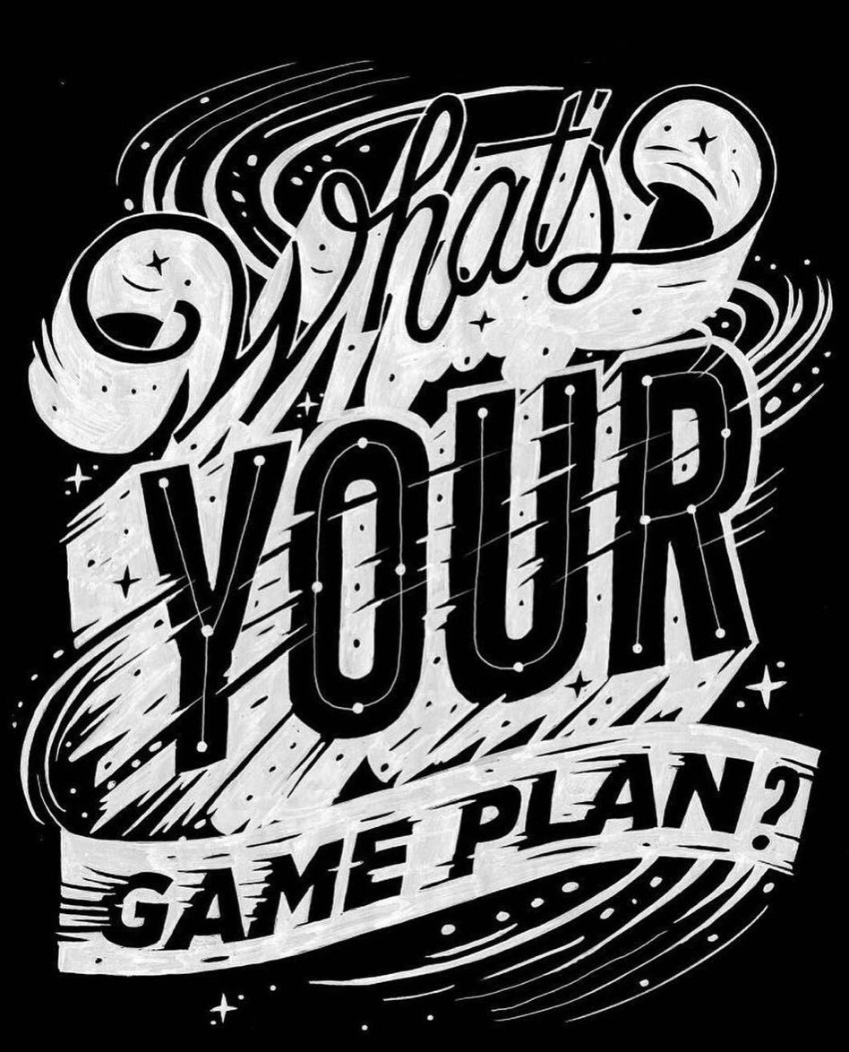
June 12, 2020
Social Channel/Network: Instagram and Twitter
Target Audience: High School Students
Actual Text:
  What’s your game plan? Have you thought about what you are going to do after high school? Design gives you a chance to express yourself and make other people’s lives better. Think about going into the design field. Who knows what you can create! AIGA can help you and connect with designers of all levels. See what they can do for you today!
Links:
  https://www.aiga.org
Influencers: Jessica Walsh
Results/Data

Slide 7
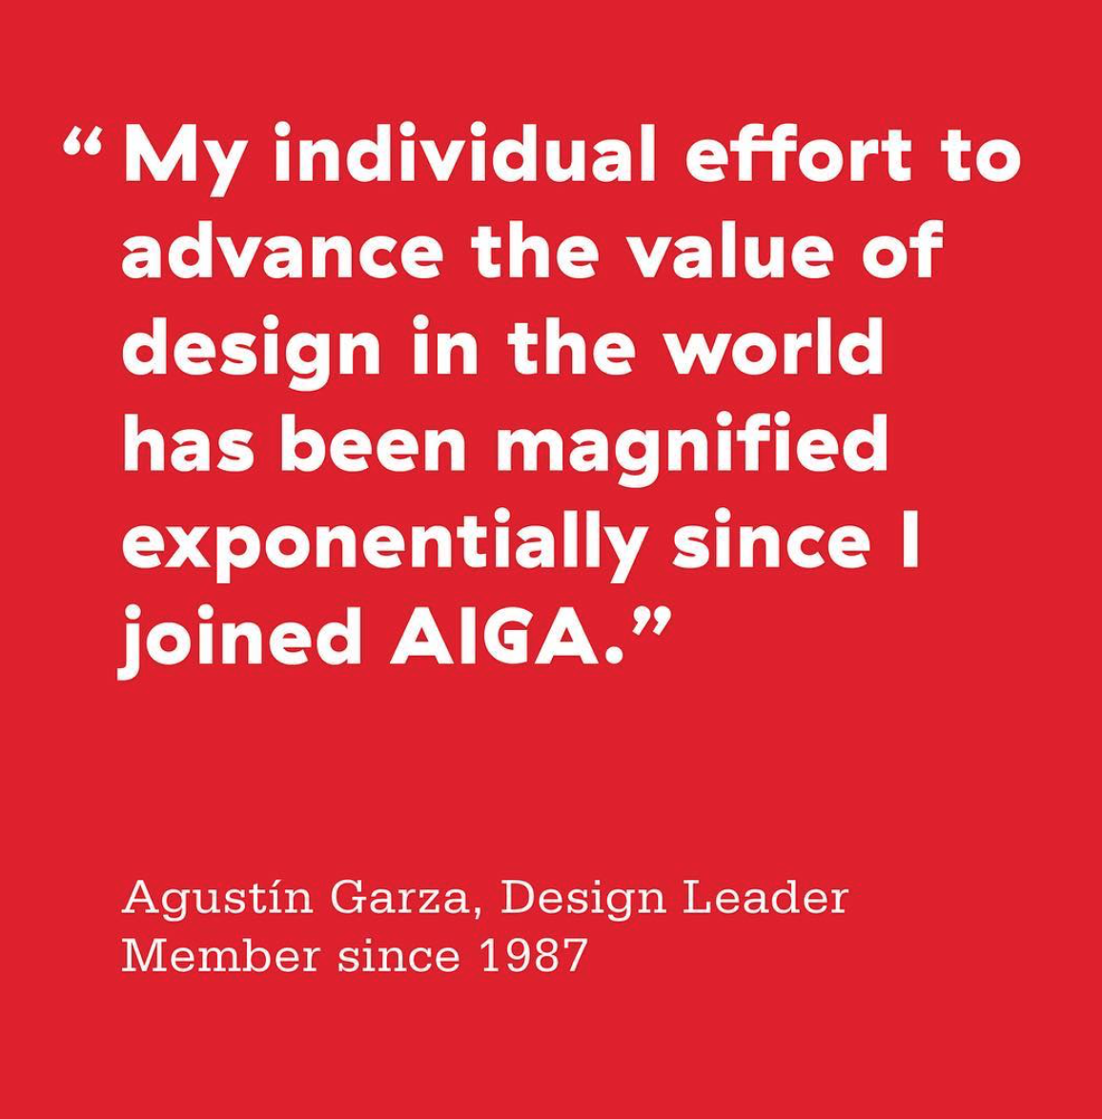
June 13, 2020
Social Channel/Network: Twitter
Target Audience: Design Students
Actual Text:
  Agustin is just one of millions of designers whose lives have been changed for the better since joining AIGA. Imagine the impact you can create in this rapidly changing world. Join AIGA today.
Links:
  https://www.aiga.org
Influencers: Laura Price, Glen Keane, Steve Jobs
Results/Data

Slide 8

June 14, 2020
Social Channel/Network: Twitter
Target Audience: All Designers
Actual Text:
  Design is everywhere you look in world. From web to mobile to print, design has been right in front of you your whole life. AIGA helps expand your skills and knowledge with support and resources. Let’s see what you can add to the design world!
Links:
  https://www.aiga.org
Influencers: Jessica Hische, Jessica Walsh, Stefan Sagmeister
Results/Data

